Slide 1

Next Gen Employee Analysis 25/10/2025

Slide 2
Problem
Next Gen is a startup tech company specializing in innovative hardware and software solutions.
The company is striving to maintain high employee satisfaction and performance while reducing turnover rates.
However, the HR department is facing challenges with a high turnover rate and an imbalanced ratio of low- to high-performing employees.

Slide 3

Solution
Through root cause analysis, the company aims to explore underlying factors contributing to poor performance and high turnover.
By identifying key patterns early, Next Gen can implement targeted interventions to improve retention, enhance performance, and ensure fair compensation across departments.

Slide 4
Tools Used
SQL
Power BI

Slide 5
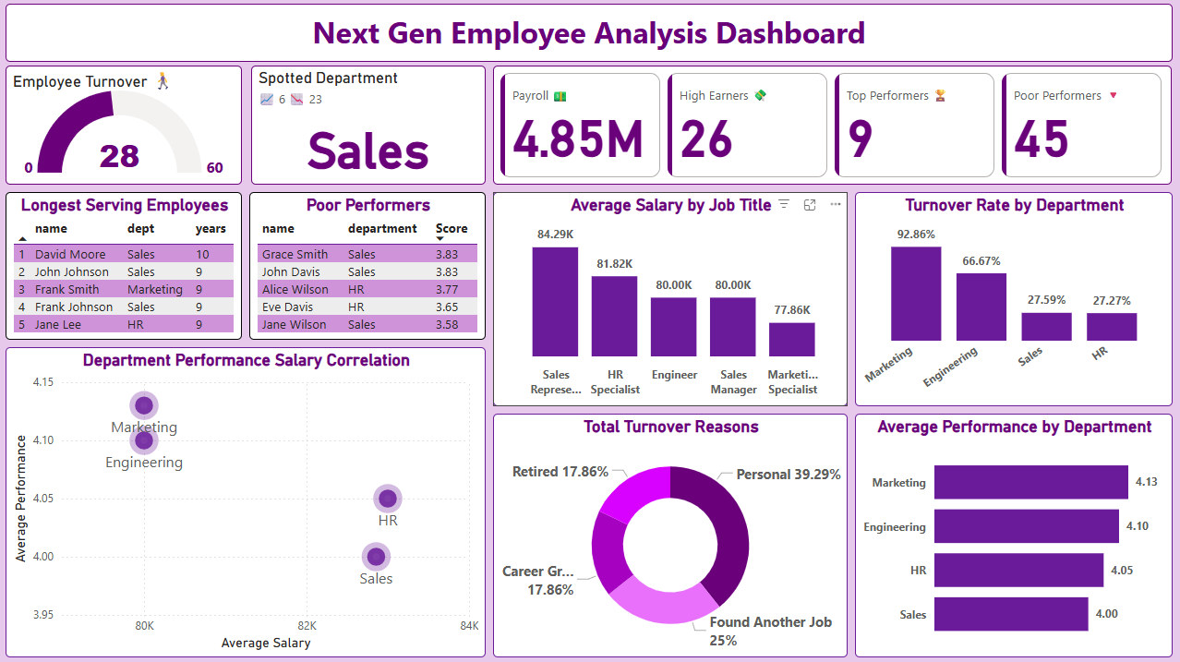

Slide 6
Employee Retention Analysis

Slide 7
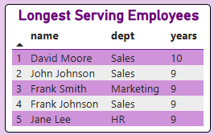
Longest serving employees
David Moore – most loyal employee, over 10 years at Next Gen Corp.
John Johnson – close to reaching the decade mark.
3 of top 5 are from Sales; 1 from HR, 1 from Marketing.
No engineers on the list → possible burnout or low pay issues.

Slide 8
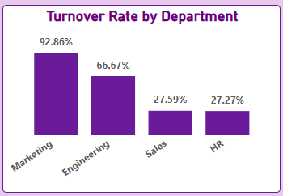
Department Turnover rate
Marketing shows the highest turnover at 92.86%.
66.67% of Engineering employees have left.
Sales and HR have the lowest turnover (<30%).

Slide 9
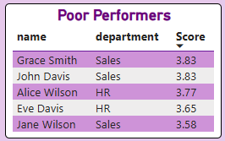
Employees at risk of leaving
Most of the lowest-performing employees are from the Sales and HR departments, with the majority in Sales.
This suggests that the Sales department’s commission-based structure may be impacting overall performance.
Some of the HR underperformers appear to hold managerial roles, where limited oversight might influence performance outcomes.

Slide 10
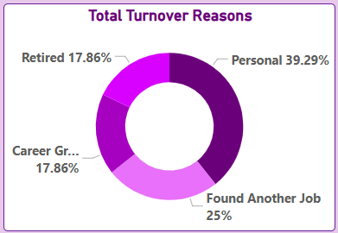
Main reason for turnover
It is 39.29% most likely for turnover to be personal reasons.
Its also 25% likely for an employee to find another job
Both career growth and Retire have a 17.86% contribution to turnover

Slide 11
Performance Analysis

Slide 12

Total employees that left
46.67%
of employees have left the company, in 2024 (15) and 2025 (13), mostly due to personal reasons, and only 25% leaving for other jobs rather than career growth.

Slide 13
score of 5.0 / below 3.5?
In the entire company tenure, its has only happened 9 times that a colleague got a 5/5 performance score, while 45 times employees performed at 3.5/5 and below.
Out of the 9 times, 6 of these emerged from sales department.

Slide 14
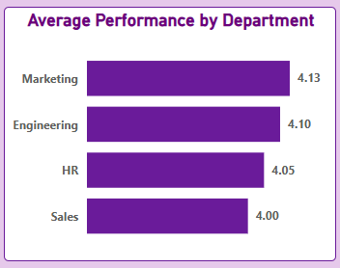
Department Performance
All departments have a performance average of above
4.0+

Slide 15
Salary Analysis

Slide 16

Total Salary Expense
4.85M
Is the total salary Next Gen Has Spent on employee compensation based on 2024-05-03 salary compensations

Slide 17
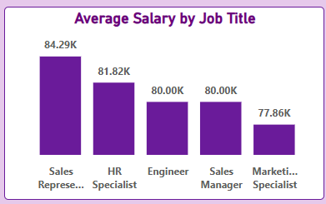
Salary By Job Title
Majority of the departments have a compensation of 80K and above, only Marketing specialists' compensation is 77.86k

Slide 18
Employees Earning More than 80K
26
Are high earners
Majority being sales representatives

Slide 19
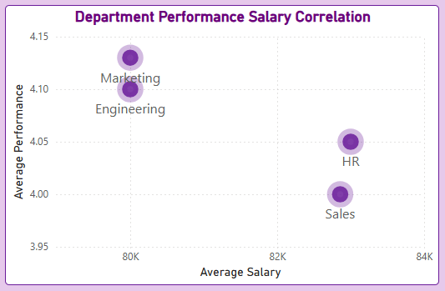
Department to salary correlation
Departments with the highest salaries are showing lower performance.
Marketing & Engineering: Performance 4.10–4.13, Salary $80k → solid performance with moderate pay.
HR: Highest Salary $83k, Performance 4.05 → high pay, slightly lower performance.
Sales: Salary $82.86k, Performance 4.0 → highest pay among low performers.

Slide 20
Insight Deep Dive
Sales emerged as the department with most employees getting a perfect average performance score of 5.0. However, this number signposted to the 23 employees getting an average of 3.5 and below is alarming. This shows that the best department is also the poorest in performance.
It is shocking that sales managers receive 80k while they colleagues under their management, the sales representatives are earning an average of 84.29K.
This nuance might be a possibility that sales representatives are getting commissions and incentives.

Slide 21
Insight Deep Dive
HR tends to reward the employees from HR favourably than any other department this explains why HR has the lowest turnover rate of all departments.
Marketing specialists being the only departments with an average salary below 77.86k correlates with the 92.86 turnover rate in this department, furthermore this is the top performing department.

Slide 22
Employee Retention Recommendations
Enhance Onboarding and Engagement Programs: Introduce mentorships and career development initiatives, along with regular employee satisfaction surveys to gather feedback.
Conduct Exit Interviews: Utilize exit interviews to understand key pain points beyond “personal” such as compensation, management issues, and workload concerns.
Promote Internal Mobility and Career Advancement: Offer regular training sessions, eLearning opportunities, and job shadowing to prepare current employees for promotions.
Identify Early Warning Signs: Look for indicators beyond low performance and attendance, such as colleagues' willingness to accept temporary promotions or participate in internal social gatherings, to gauge engagement levels.

Slide 23
Performance Recommendations
Performance-Based Recognition Programs: Recognize and reward employees for their hard work with incentives such as in-store discounts, "Department of the Quarter" awards, and "Employee of the Month" acknowledgments.
Targeted Training: Implement customized training programs tailored to the specific needs of each department.
Data-Driven Performance Tracking: Utilize dashboards and reports to visualize performance data, enabling HR teams to easily identify the lowest-performing departments.
Balanced Workload Across Teams: Encourage regular, real-time work management across teams to ensure that workloads are distributed proportionately among employees.

Slide 24
Salary & Compensation Recommendations
Standardize Pay Structures: Ensure that base salaries are consistent across similar roles and pay grades.
Introduce a Pay-for-Performance Model: Reward high performers, such as marketing specialists, with bonuses instead of incorporating these rewards into their monthly base salary.
Regular Salary Reviews: Conduct annual compensation reviews to align with the median national wage and adjust for the cost of living accordingly.
Address Pay Disparities Across Departments: Adjust salaries in the marketing department to align with the company-wide base salary of $80,000.
Encourage Employee Unions: Support the formation of self-governed employee unions that can advocate for employees anonymously, fostering transparency, trust, and long-term engagement.

Slide 25
Caveats
The salary dataset only projects for payroll date 2024-05-03 and should be treated with caution.
Data is majorly dependant on quotative analysis and so the exact personal reasons for turnover have not captured the nuances of the actual turnover reason

Slide 26

Thank You.

